Slide 1


BSc Hons Computer Games Design and Development GDV4000 Introduction to Games Industry Practice
Game Design and Mechanics – Game Genres – Platform Games

Slide 2
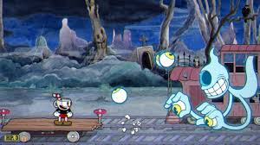
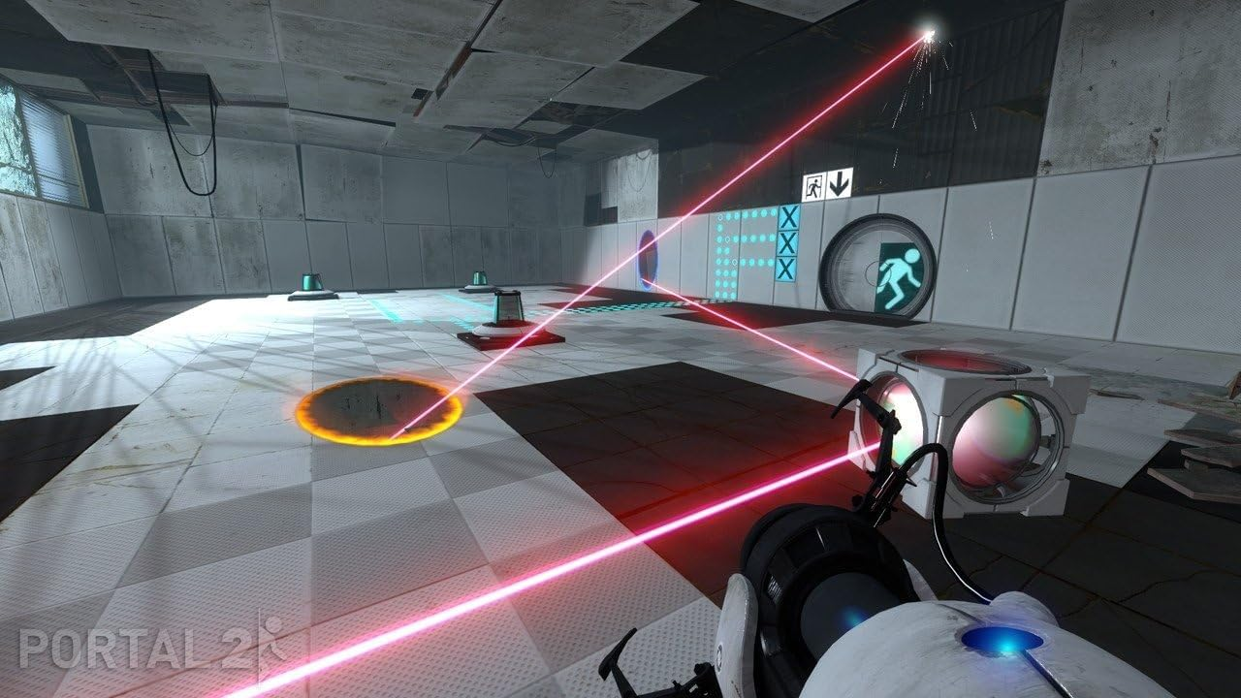
Platform Games/ Platformers
Sub-Genres of Platformer:
Run-and-Gun – A hybrid of platform and shoot-em-up. The focus is on attacking rather than problem solving and puzzles.
Contra
Cuphead
Commando
Puzzle Platformers – Puzzle is integral to gameplay, in addition to navigating a platform-based environment. Games like Lemmings and Doki Doki Penguin Land involve guiding/shepherding characters to points on the map in order to save them. Portal uses physics and platform mechanics to solve puzzles. Braid use time manipulation as a means to solve puzzles.
The Lost Vikings
Portal 2
Fez
Cuphead ©Studio MDHR
Portal 2 ©Valve Studios

Slide 3
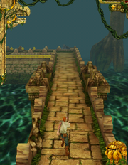
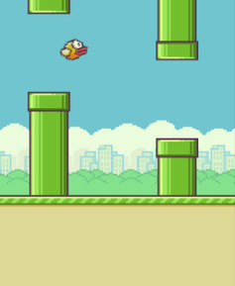
Platform Games/ Platformers
Types of platformer:
Infinite/Endless Runner – Popular on mobile devices given the limited controls. Players navigate a (typically) procedurally generated environment.
Temple Run
Flappy Bird
Pitfall!
Platform Adventure – Mixes free-roam with platforms, which means you can explore the world in any direction. Can be extended to include RPG elements.
Legend of Zelda
Hollow Knight
Oddworld

Slide 4
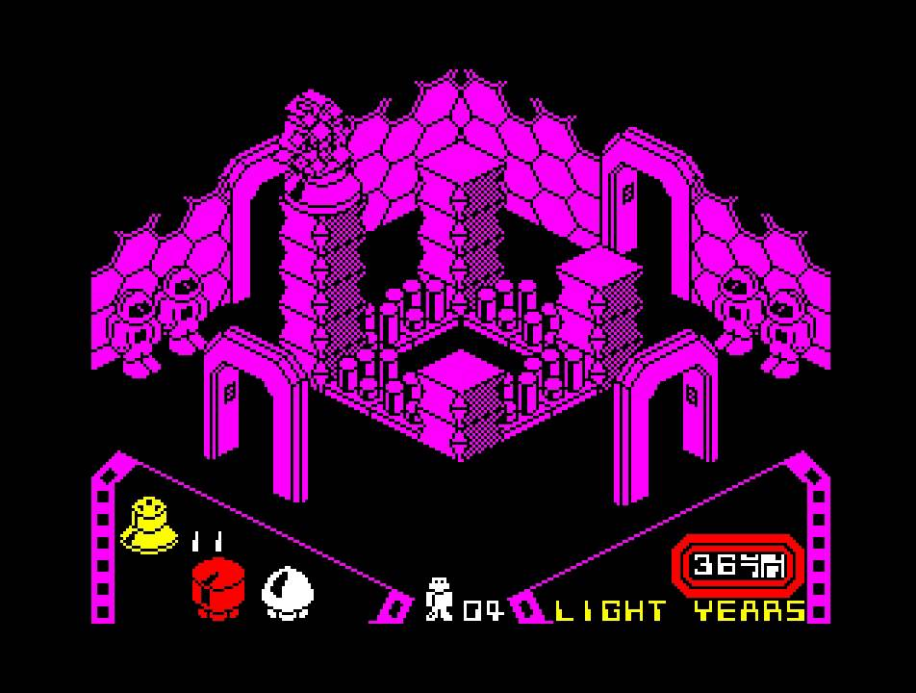
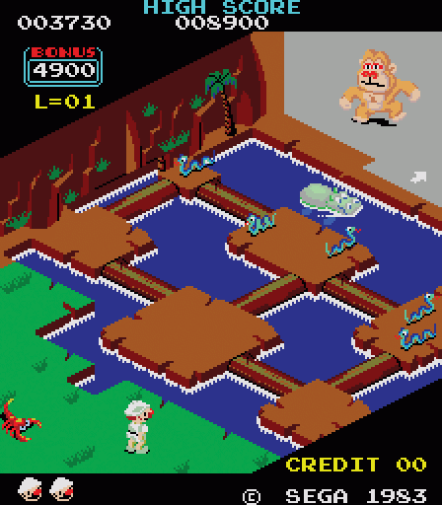
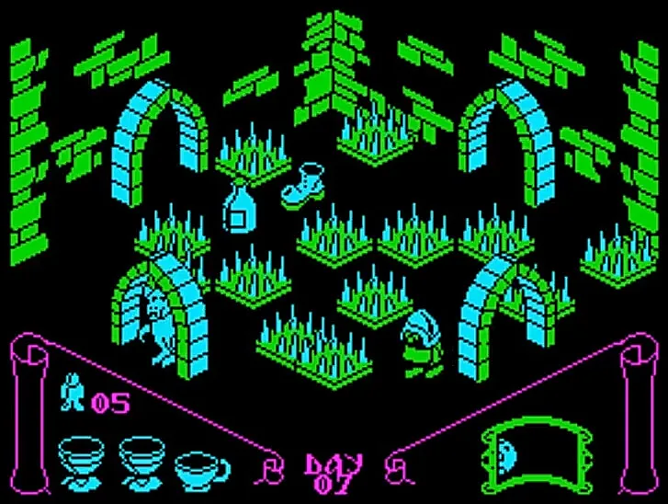
Platform Games/ Platformers
Sub-Genres of Platformer:
Isometric Platformers – Platform mechanics and gameplay shift into 3D. Early games in this sub-genre were purely sprite-based, but advancements in 3D hardware and capabilities make this more of a design choice than a technical necessity.
Congo Bongo
Knightlore
Alien8
Alien8 ©Ultimate Play The Game 1985
Congo Bongo ©Sega 1983
Knightlore ©Ultimate Play The Game 1984

Slide 5
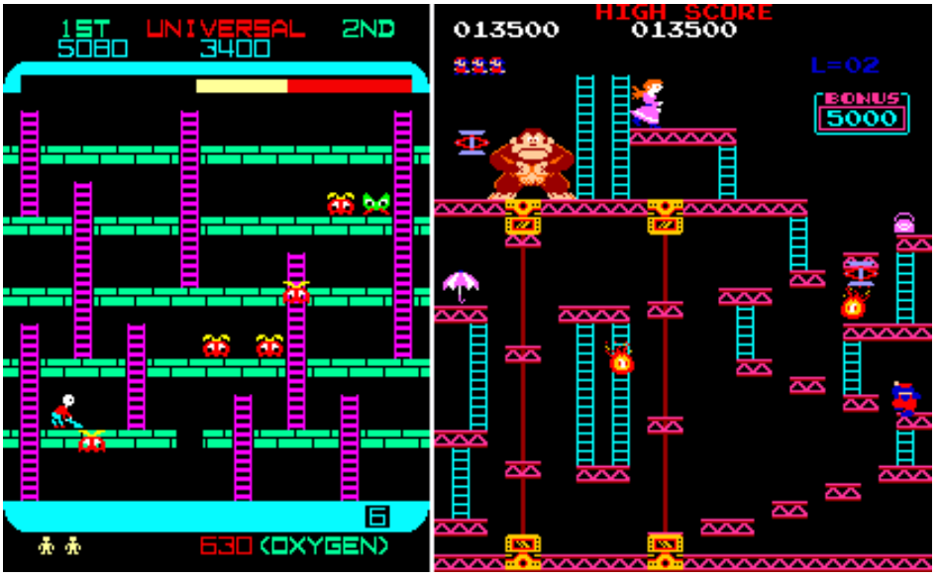
Platform Games/ Platformers
Nintendo’s Donkey Kong (Miyamoto, 1981) is often credited as being the first platformer. Alt (2023) suggests that the credit actually belongs to Space Panic (Universal, 1980), which does bare a strong resemblance to Donkey Kong.
Both games utilise platforms, ladders, and obstacles (aliens and barrels respectively) that will kill the player on contact.
In both games, the player needs to avoid the obstacles and climb the ladder to the top of the screen to progress to the next screen/level. Being confined to a single screen was due to technical limitation of the hardware.
However, the real difference is the use of gravity in the game. In Donkey Kong Jumpman (before his name was changed to Mario) jumps over the barrels, whereas in Space Panic our player digs holes in the platforms to trap the aliens and then fills them up, causing the alien to fall.
Space Panic (1980) ©Universal
Donkey Kong (1981) ©Nintendo
It has been argued that Donkey Kong had a much broader appeal and popularity than Space Panic, and that subsequent platformers probably owe more to Donkey Kong for establishing the expectations of the genre (Retrogame Deconstruction Zone, 2020).

Slide 6
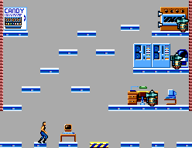
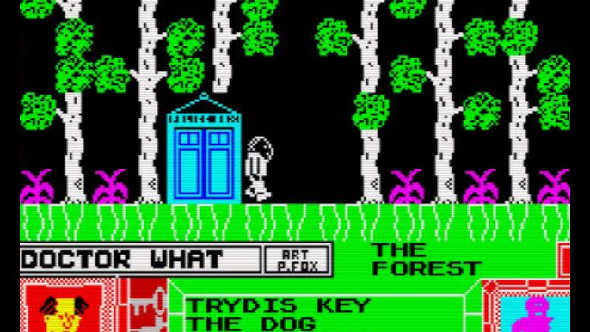
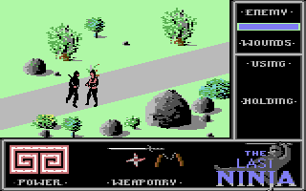
Platform Games/ Platformers
Platform games changed as technology expanded, enabling the player to go beyond the confines of a single screen.
Flip-Screen – When reaching the extreme left or right of the screen, the next screen is drawn and is designed to be a continuation of the same space, with the player being positioned on the opposite side to where they left the previous screen. Enemy NPCs were confined to their own screen.
Sierra’s Quest for Glory series allowed enemy NPCs to follow the player screen to screen.
Flip-Screen was more popular on home computers, which were generally not technically capable of handle scrolling.
Impossible Mission ©Epyx 1984
Doctor What! ©CRC 1985
Aside - Although more an Action/Adventure title than a platformer, The Last Ninja games were very creative with their flip-screen design. The next screen is drawn/generated in front of the player from back to front, with trees and props generated last.
The Last Ninja ©System 3 1987

Slide 7
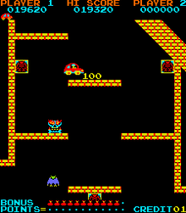
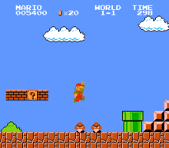
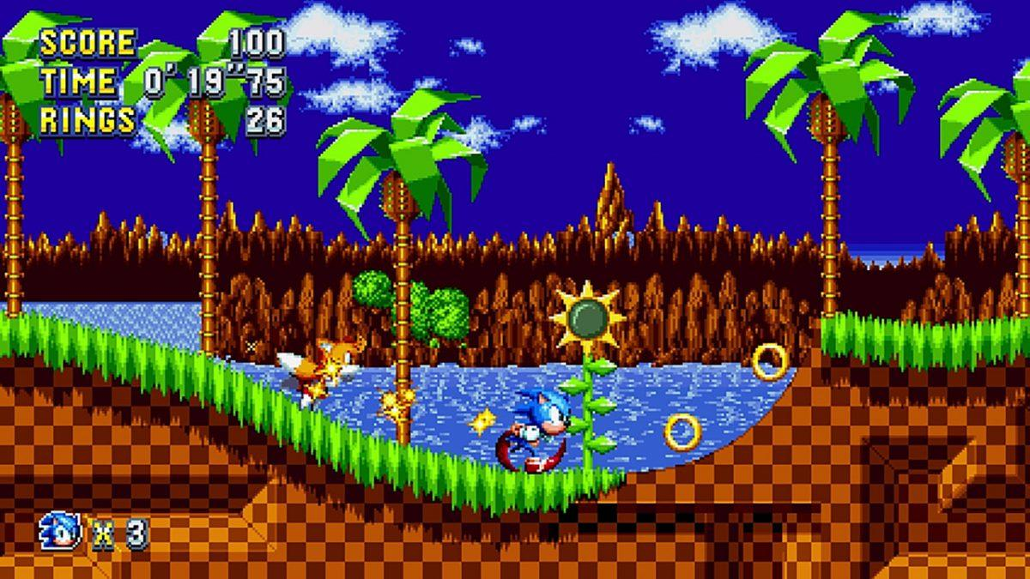
Platform Games/ Platformers
Scrolling Platform Games
Jump Bug in 1983 was the first platformer to introduce scrolling. Super Mario Bros in 1985 was based on this.
Jump Bug also established the foundation upon which many popular platform games went on to follow – a 2D world populated by 2D platforms which the player needed to navigate by jumping and/ or climbing.
Going into the 90s –
The 16-bit consoles began to lift some of the previous generation’s hardware limitations.
Sega’s 1991 hit Sonic the Hedgehog took the elements that games such as Super Mario Bros had introduced but added a main character that moved at high speed. The levels were designed to support this with a smooth flow and ramps to enable high jumps.
Platform games of this era also started to use parallax scrolling, giving the illusion of depth by having the background move as a different speed to the foreground.
Jump Bug ©ADK Corporation 1983
Super Mario Bros ©Nintendo 1985
Sonic the Hedgehog ©Sega 1991

Slide 8
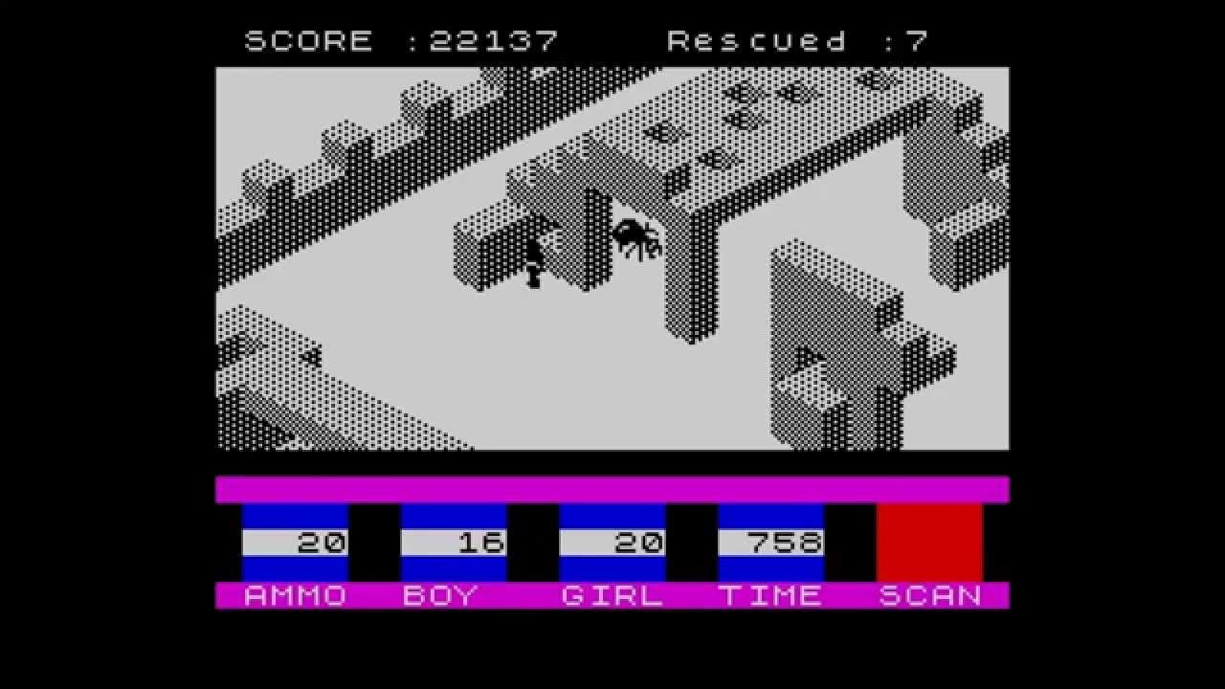
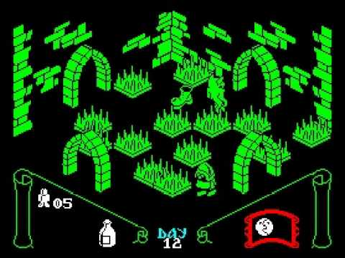
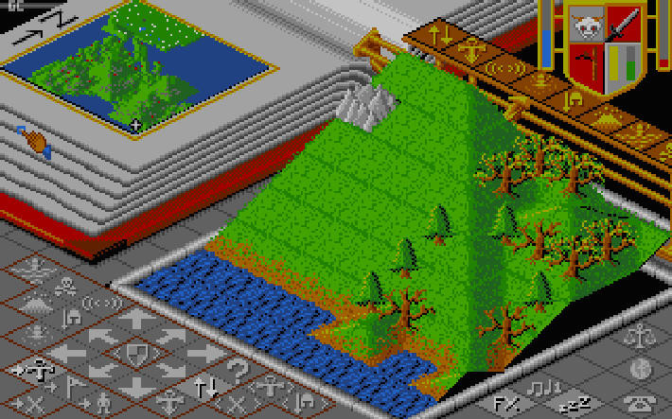
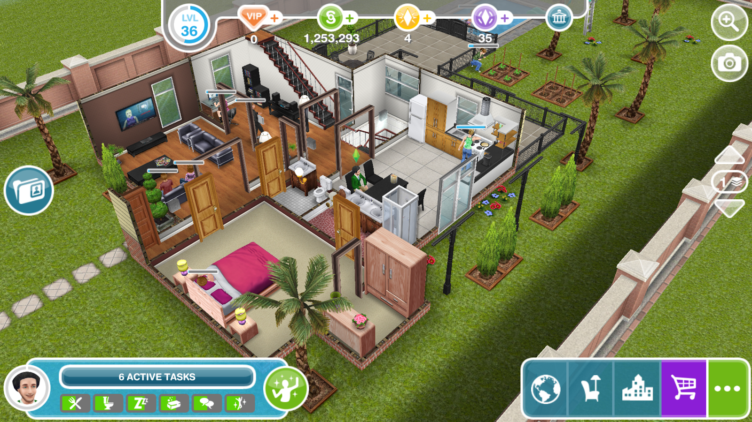
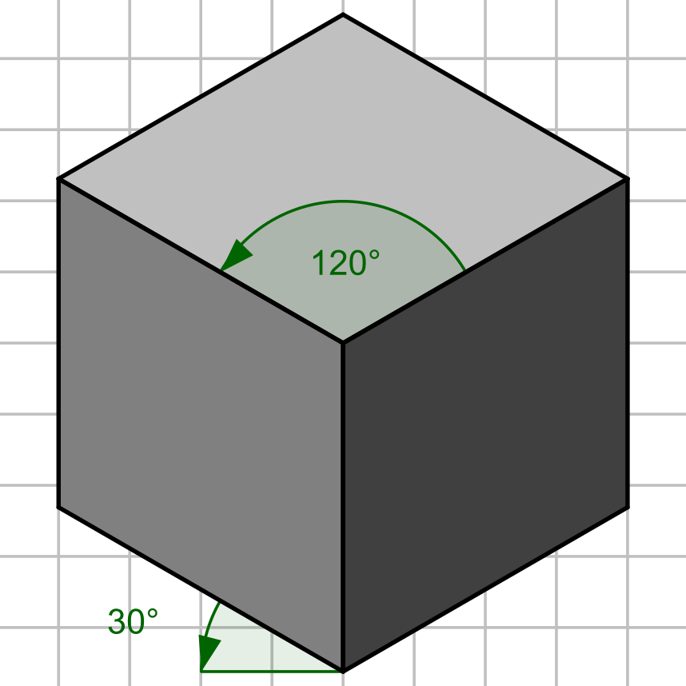

Platformers go 3D (nearly)!
Not all platformers are side-on 2D. Some early platform games were isometric-based, where the player view-point is positioned above and at an angle.
Some notable isometric platform games:
Marble Madness
Knightlore
Head Over Heels
Ant Attack
The term isometric derives from the angle that objects are being viewed from.
Greek – Isometria:
Iso = Equal
Metric = Measuring

Slide 9
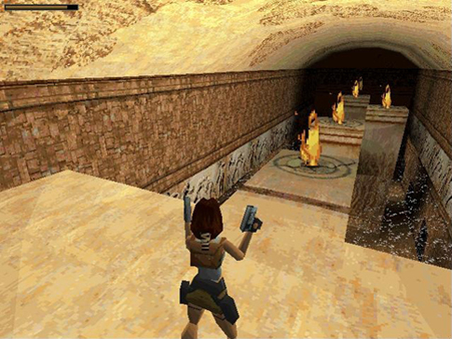
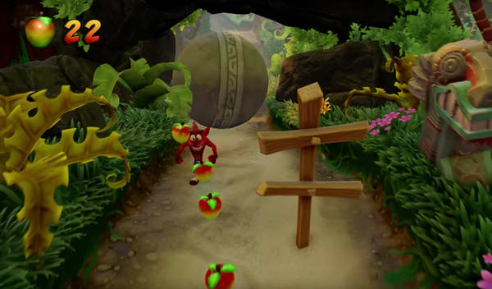
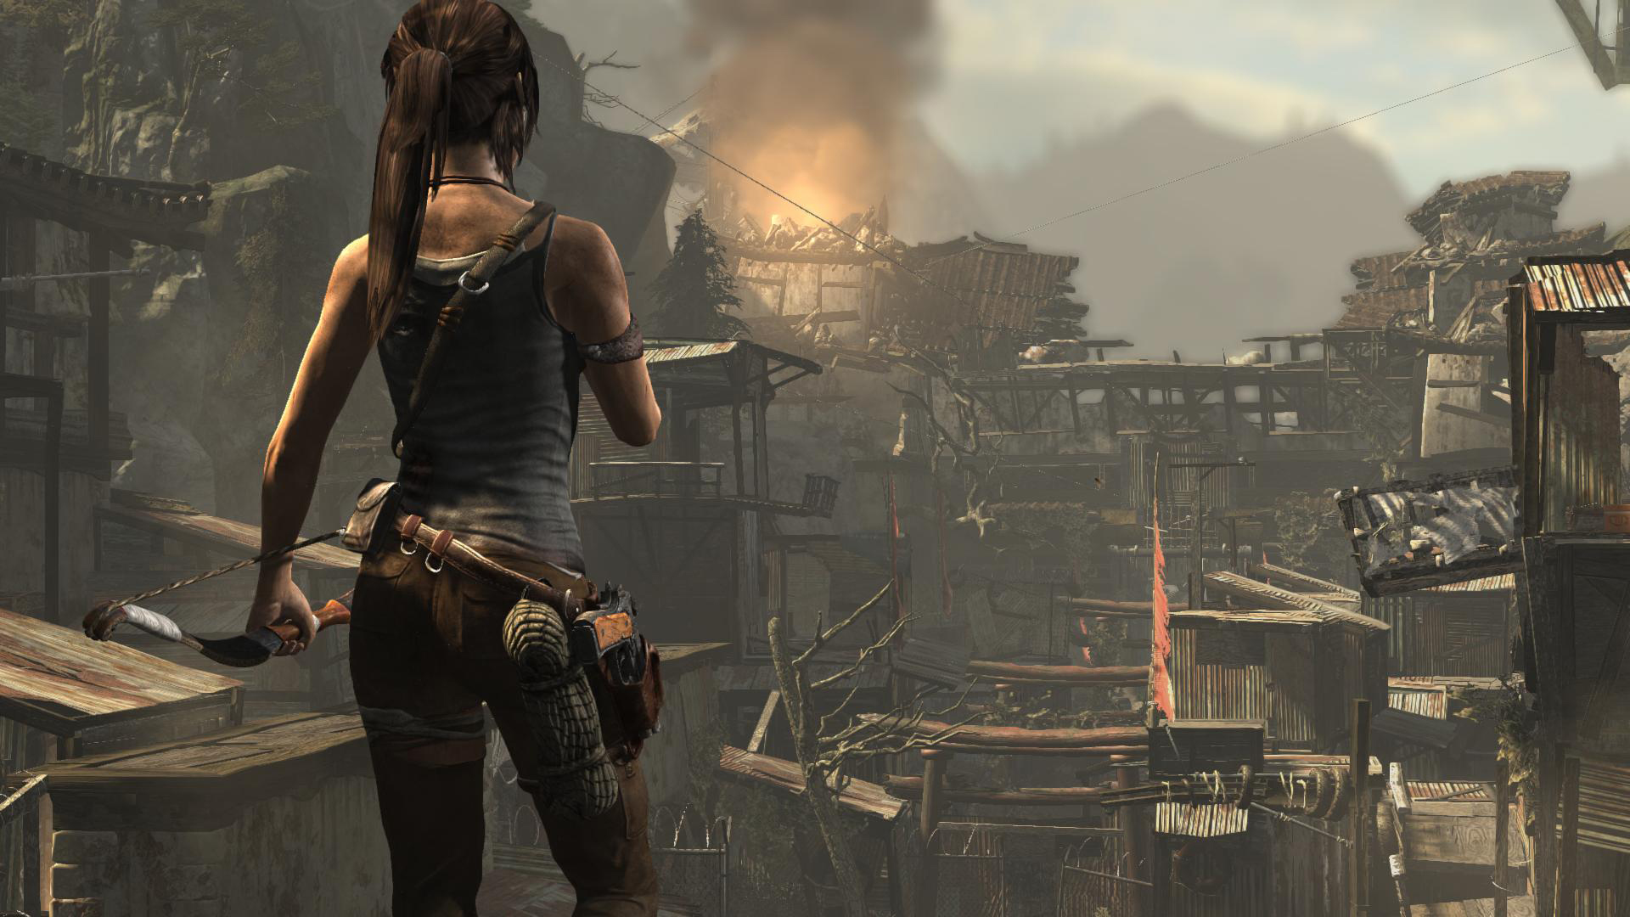
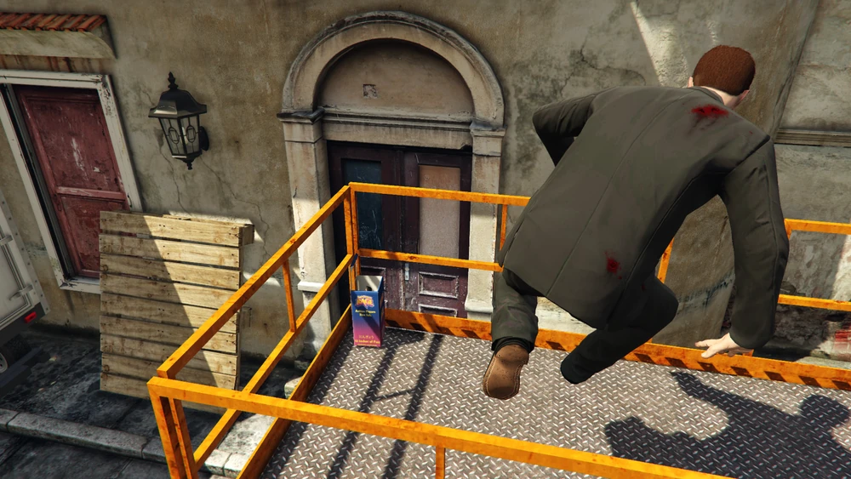
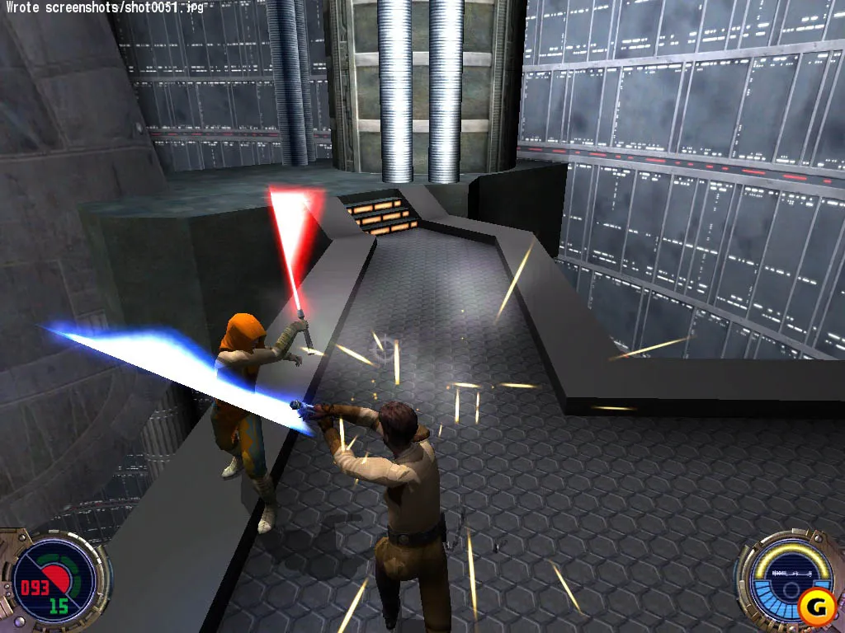
Platformers go 3D (actually!)
Platform game mechanics have now evolved beyond being a distinct genre. Fully immersive 3D environments have opened up the potential for adding platform mechanics into other genres, such as Action/Adventure.
The Thief and Hitman series’ make use of platform mechanics to enable the player to access buildings in different ways.
The parkour mechanic in the Assassin’s Creed series.
The GTA Online Mission “Gerald’s Last Play: Go Figure” has the player climbing onto various ledges and rooftops to collect action figures.

Slide 10
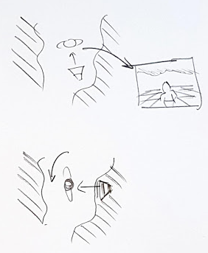
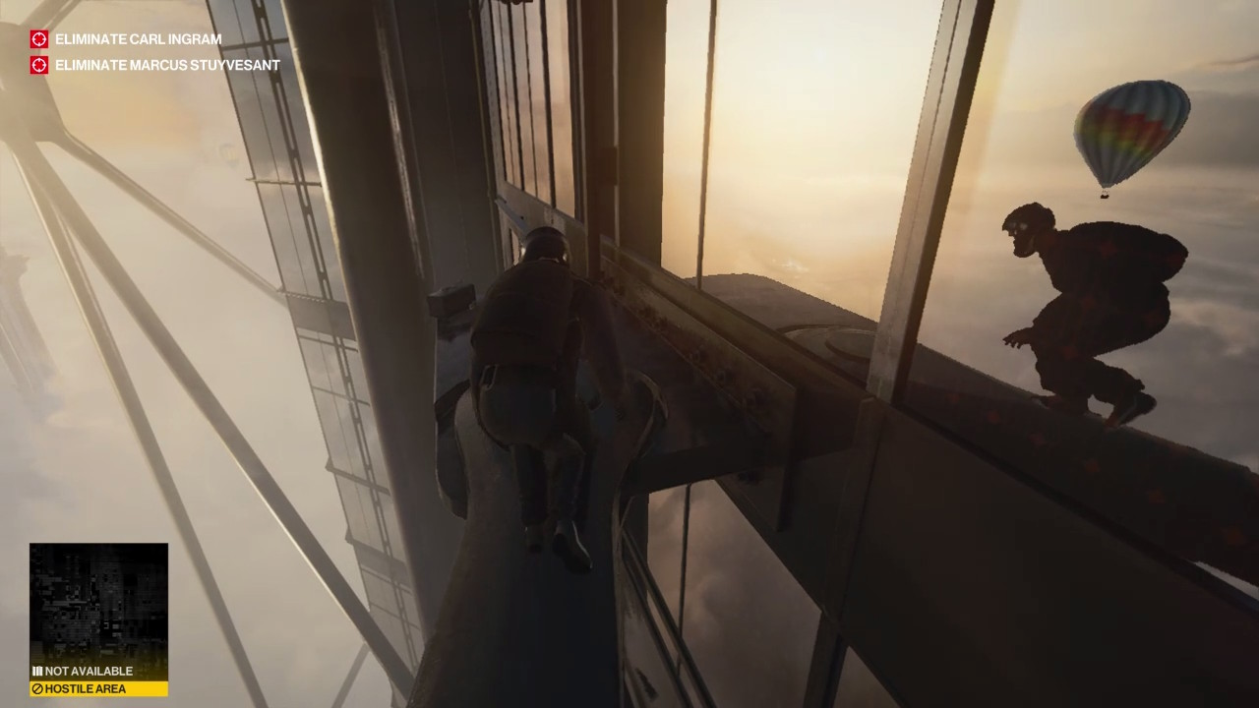
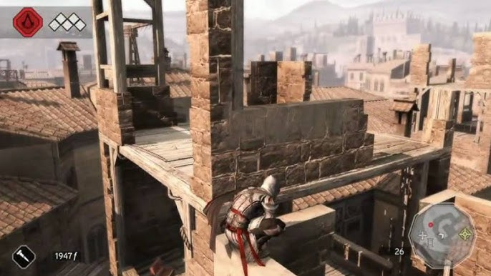
Platformers go 3D (actually!)
3D Platfomers present many challenges to the developer, not least of which is how to manage the camera.
First-Person Camera – Affords an unobstructed view of the environment (at eye-level) but can become much harder to gauge distances between jumps.
Third-Person Camera – Positioned around the Player Avatar, generally behind and elevated, and can be moved independent of the Player position. This can make gauging jumps and scouting ahead much easier, but consideration needs to be given as to how the camera behaves when intersecting buildings and scenery.
Camera located behind the player
As the player rotates, if the camera’s position remains fixed – relative to the player, it might intersect the scenery).

Slide 11
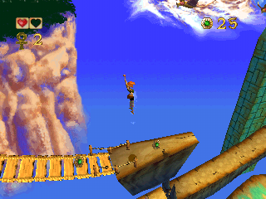
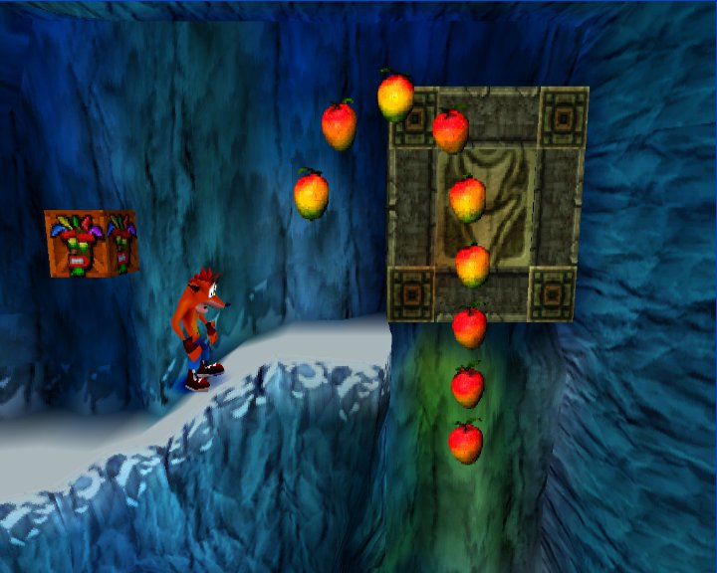
2D Mechanics in a 3D World
Some platformers have a 3D environment but are restricted to 2D-style gameplay and mechanics.
Pandemonium
Crash Bandicoot
Unity and Unreal Engine can both be used to make a 2D-style game with 3D assets. Both game engines ‘cheat’ 2D, as they both still utilise the Z-Axis.
Pandemonium ©Toys for Bob/Eidos 1996
Crash Bandicoot ©Naughty Dog/Toys for Bob 1996

Slide 12
Core Mechanics
There is a common set of core mechanics on which gameplay is based:
Walking/ Running
Example: “The player navigates along a given platform, ledge, or the ground by moving left and right. It is also possible to sprint left and right to cover greater distances and allow the player to trigger longer jumps where necessary” – This describes basic walking/ running mechanics for a 2D platformer.
Jumping
Example: “The player can jump directly up by a set distance. Gravity slows the player until they stop jumping and start to fall. When jumping while walking, the player can move laterally during the jump. If sprinting, the lateral movement is much larger which means that the player can cover a greater distance”.
Other Key Mechanics (different games will have their own specific mechanics).
Ducking, Climbing, Sliding, Fire/ Attack, Defend, Interact.

Slide 13
State Modelling
When designing a game, and trying to establish the flow of the game, it can be useful to identify the different states a character will be in (walking, running, jumping, falling etc.) and how a character goes from one state to the next.
State-chart diagrams are typically found in the Technical Specification, but a more basic overview of the different states as done by the designer could aid in expressing the gameplay and flow of the game.
Standing
Fall off edge
Land
Stop moving [speed >= T]
Falling
Running
Jump pressed (enter lateral jump)
Land / Hit Ground too fast
Sliding
Move player
Standing
Jumping
Hit obstacle
Stop moving [speed < T]
Die
Comes to a stop
Jump pressed (enter vertical jump)
Actions / events that change states
Character states

Slide 14
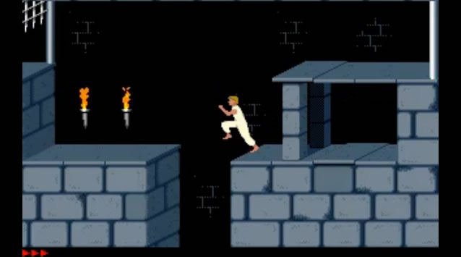
Puzzles and Props – Level Design Considerations
We have looked at puzzles in games. Let’s look at some considerations and examples of how they are implemented in Platformers:
Dexterity
The most common type of challenge in the genre, testing the player’s skill at navigating the environment.
Games like Prince of Persia took an extreme approach to this idea, requiring pixel-perfect accuracy when timing jumps.
A design document might include illustrations about this requirement for the level designers and programmers.
At the start of the jump animation sequence the player’s foot position must be within 5 pixels of the platform edge.
Gaps are 50 or 60 pixels wide. For a 50-pixel gap, the player can jump and land on the target platform. For 60-pixel gaps, the player will grab the edge of the platform and require a subsequent climb action to get onto the target platform.

Slide 15
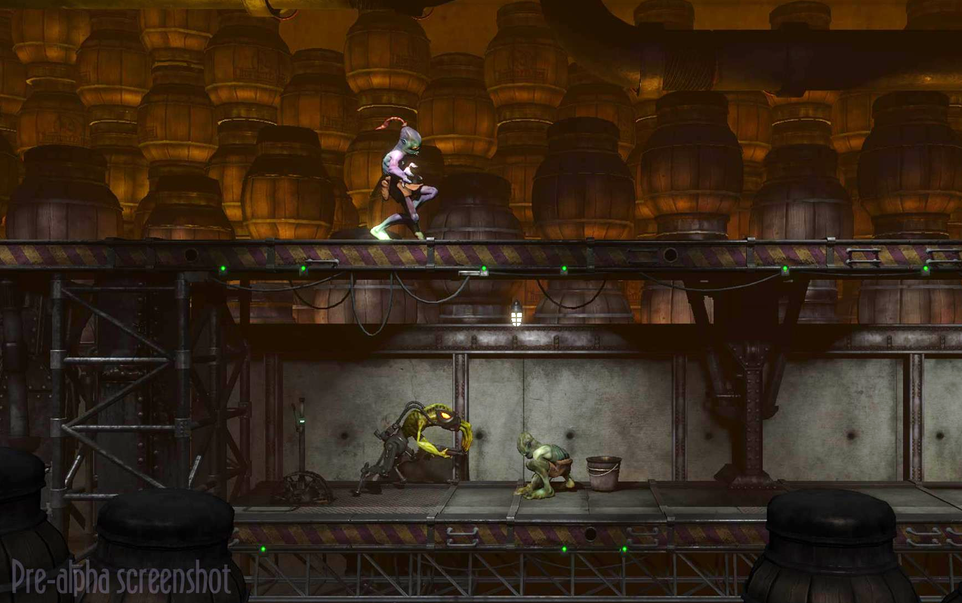
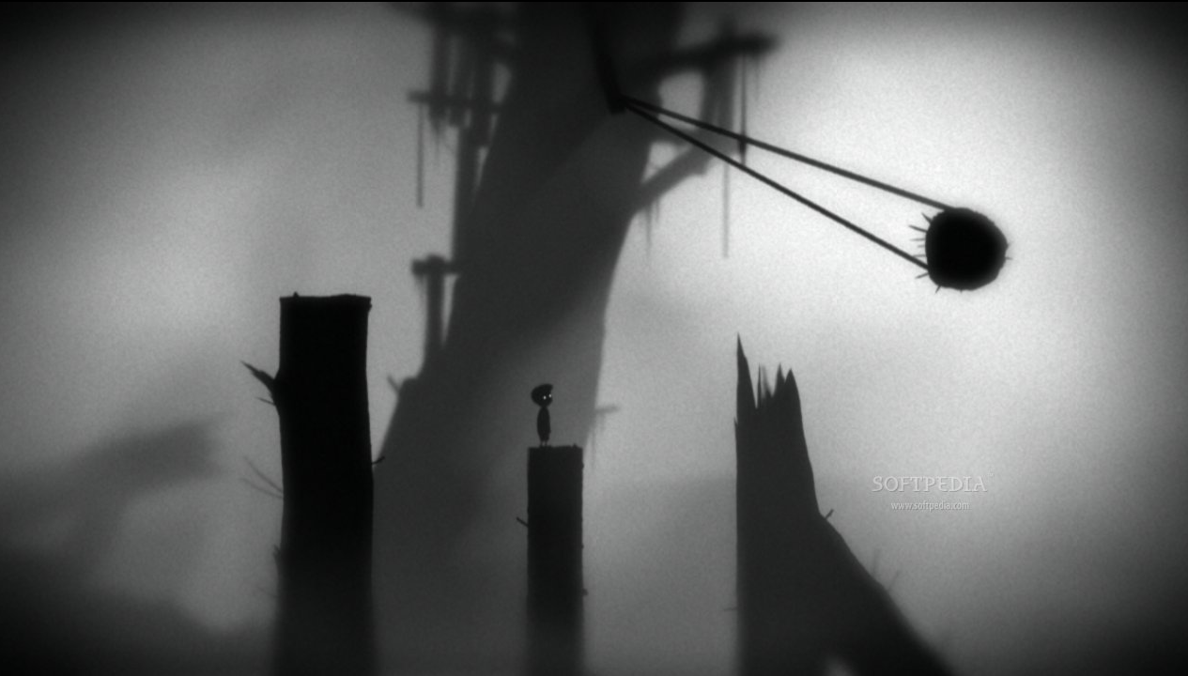
Puzzles and Props – Level Design Considerations
Logic
Logic in platform games can vary:
Finding keys to open specific doors
Collecting objects in order to complete a task
Using relevant game mechanics to manipulate the environment to achieve your goal.
Abe’s Oddysee (Oddworld Inhabitants) used mechanics (abilities) such as sneaking, talking, chanting and possessing enemies to solve puzzles and navigate through and escape Rapture Farms.
Physics
The increase in hardware capability has opened up more possibilities for different types of challenge, such as physics-based puzzles, where the player must use the environment and props/ objects within the environment to reach their goal.
Limbo (Playdead) is an excellent example of a physics-based puzzle-platform game, where objects served as hazards and in many cases had to be used cleverly to progress through the environment. This also uses dexterity and logic / problem solving elements mixed in with the physics.

Slide 16

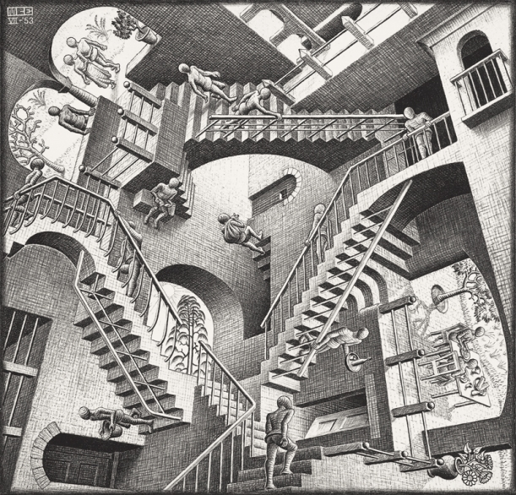
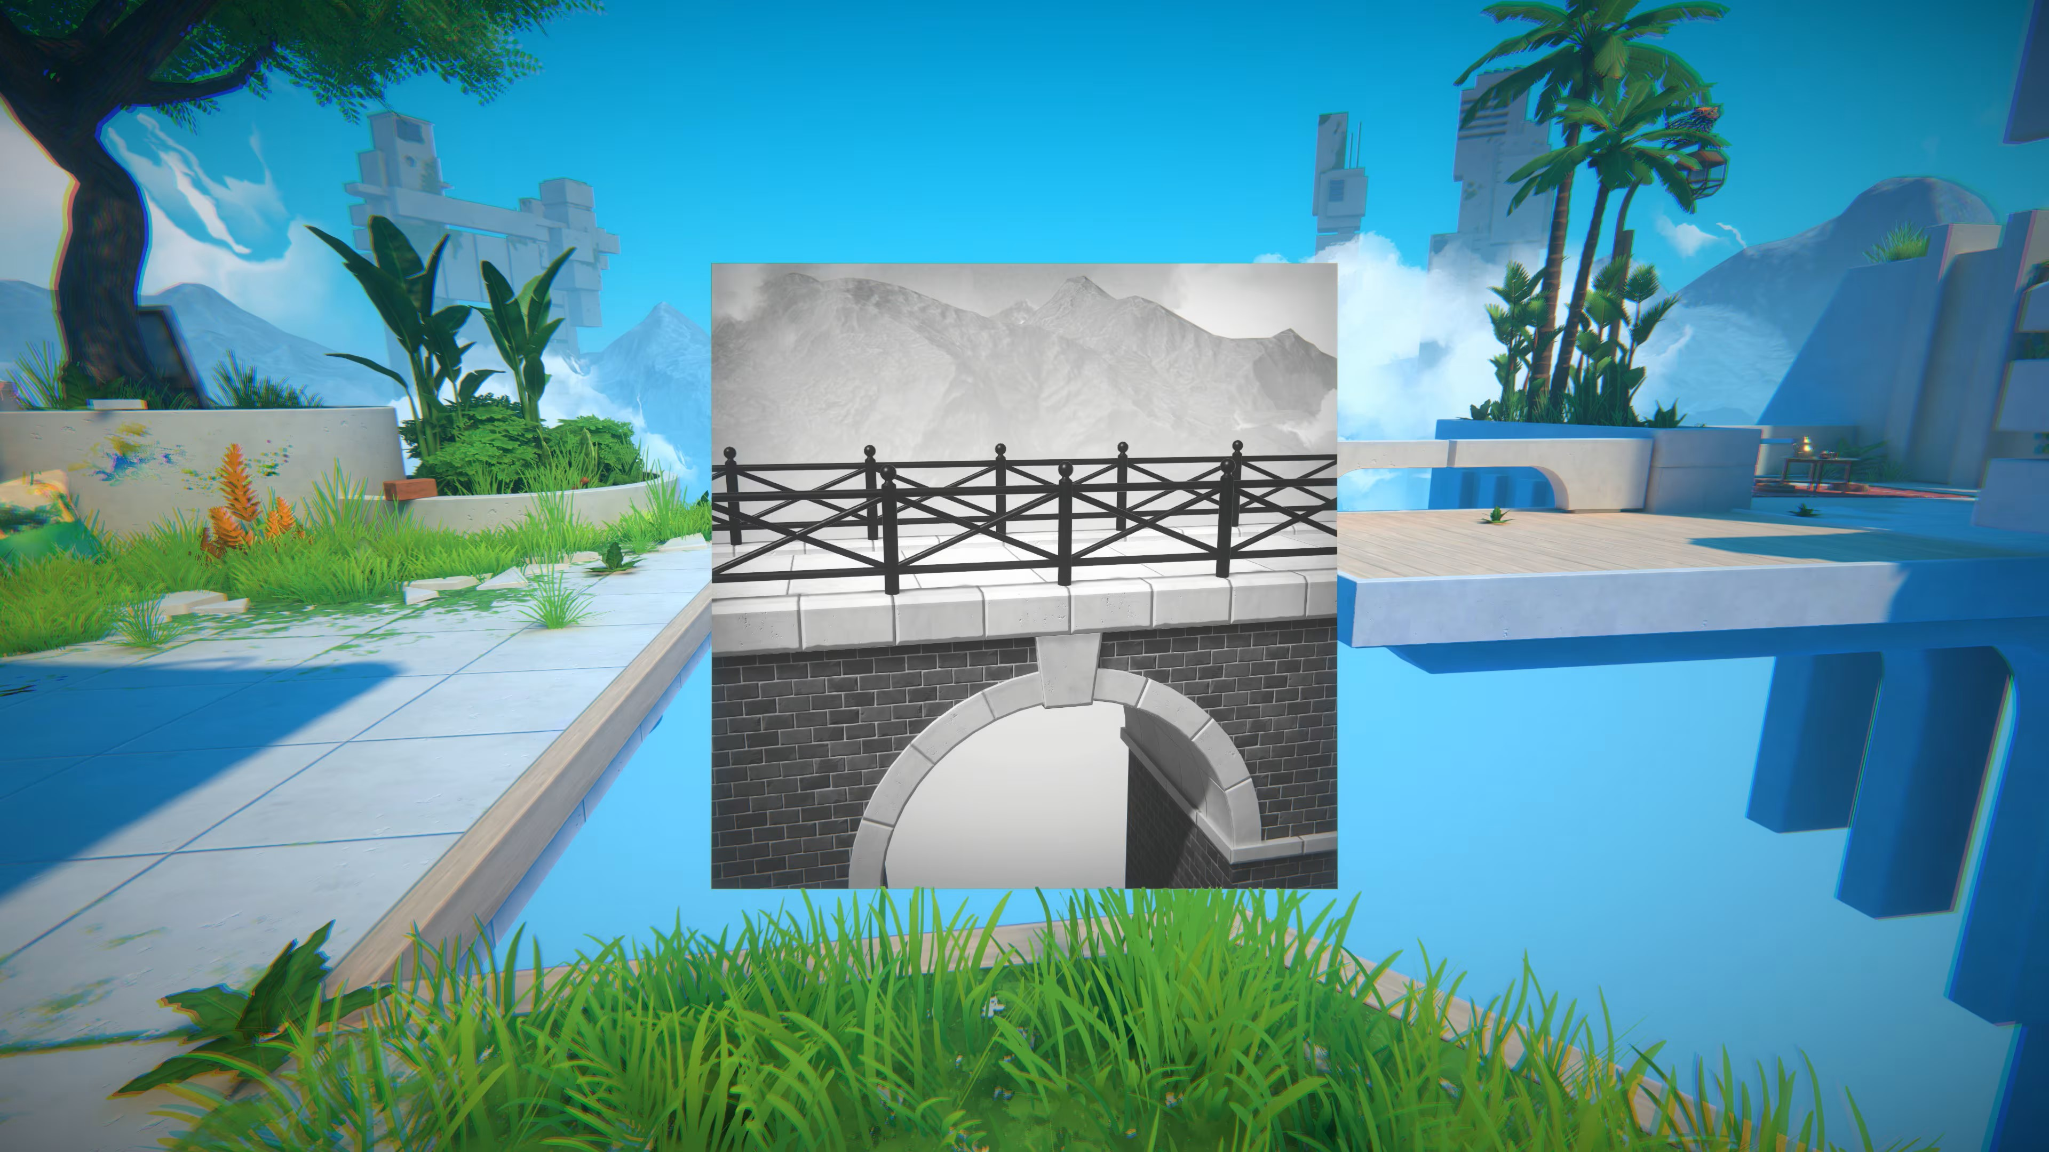
Puzzles and Props – Level Design Considerations
Monument Valley (Ustwo Games) used Escher-esque environments to provide challenges to the player.
Perception/ Environment
Some games present visual challenges to the player, where a key aspect is to find ways through the level that are not immediately obvious.
This involves using logic in combination with exploration (the player needs to be allowed to explore freely)
Viewfinder (Sad Owl Studios) uses photographs taken by the player to form new pathways through the levels in order to reach the goal.

Slide 17
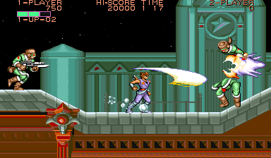
Flow Considerations
When designing a fast-paced platformer, the flow of the game needs to be carefully considered, as it impacts:
The design of the levels to support set-piece moves (Sonic the Hedgehog)
Introduce/ implement relevant mechanics to facilitate better flow:
Capcom’s Strider was renowned for fast-paced running, sliding, and 8-way movement which provided the player a greater degree of movement within the game environment.
Testing these types of mechanics, and ensuring that your level design supports them, is crucial.
Strider ©Capcom 1989

Slide 18
References / Resources
Adams, E. (2009) The Designer’s Notebook: Sorting out the Genre Muddle. Available at: https://web.archive.org/web/20141217155232/http://www.gamasutra.com/view/feature/4074/the_designers_notebook_sorting_.php [Accessed 2 November 2024]
Alt, E. (2023) A Brief History of the Platformer. Activision Blizzard. Available at: https://newsroom.activisionblizzard.com/p/a-brief-history-of-the-platformer [Accessed 2 November 2024]
Crawford, C. (1982) The Art of Computer Game Design. Chapter 3, p.23. Available at: https://www.digitpress.com/library/books/book_art_of_computer_game_design.pdf. [Accessed 2 November 2024]
• Moore, M. “Basics of Game Design” Chapter 9.
Miyamoto, S. (1981) Donkey Kong [Video Game] Nintendo.
Retrogame Deconstruction Zone (2020) What Was the First Platformer, Space Panic or Donkey Kong? [Online] Available at: https://www.retrogamedeconstructionzone.com/2020/07/what-was-first-platformer-space-panic.html [Accessed 2 November 2024]
Universal (1980) Space Panic [Video Game] Universal.

